Slide 1

職場故事
Animaze

Slide 2


目標
Notes:
https://pixabay.com/videos/keyboard-typing-writing-notebook-10822/

Slide 3
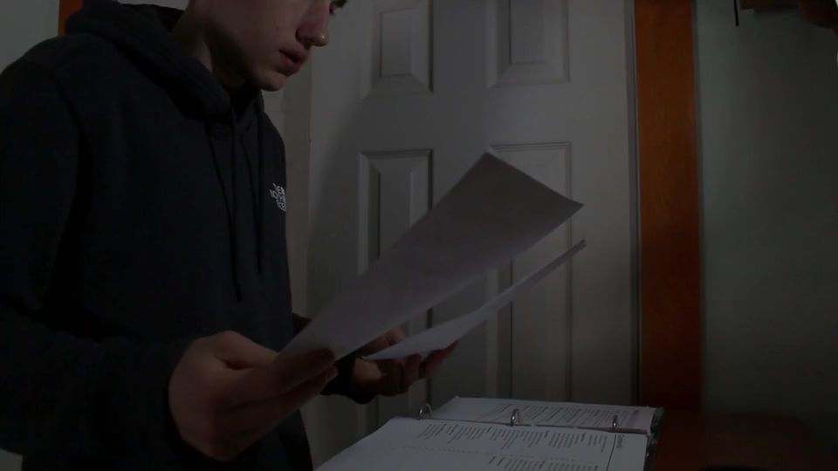
阻礙
Notes:
https://pixabay.com/videos/anxiety-stress-depression-sad-107264/

Slide 4
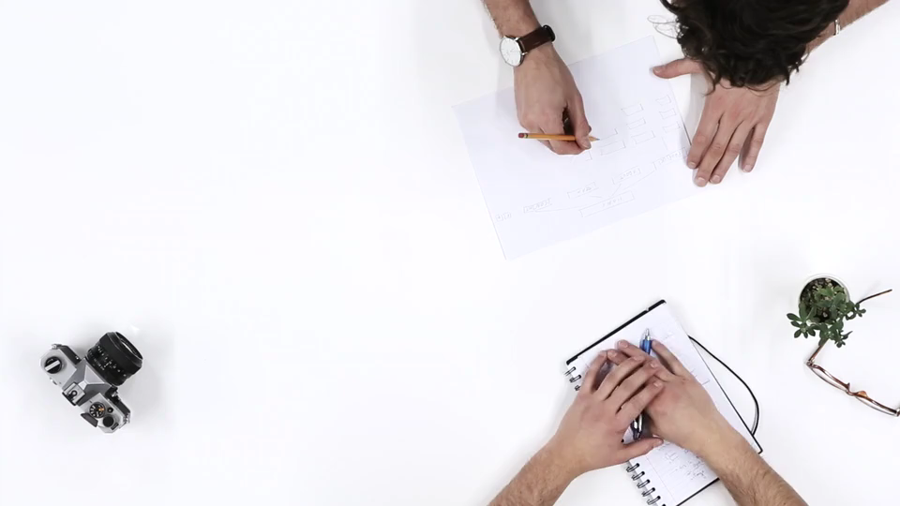
努力
Notes:
https://pixabay.com/videos/meeting-planning-marketing-business-2340/

Slide 5

結果
Notes:
https://pixabay.com/videos/hands-good-accept-vote-ok-gesture-168344/

Slide 6

意外
Notes:
https://pixabay.com/videos/heartbroken-upset-sorrow-187521/

Slide 7

轉彎
Notes:
https://pixabay.com/videos/work-office-people-working-87593/

Slide 8

結局
Notes:
https://pixabay.com/videos/business-wine-3d-cartoon-alcohol-115004/

